Slide 1


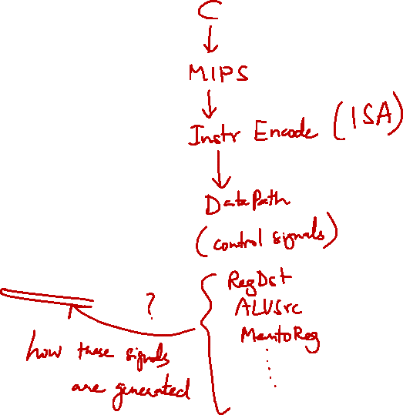
http://www.comp.nus.edu.sg/~cs2100/
Lecture #12
The Processor: Control

Slide 2

Lecture #12: Processor: Control
Identified Control Signals
Generating Control Signals: Idea
The Control Unit
Control Signals
ALU Control Signal
Instruction Execution

Slide 3
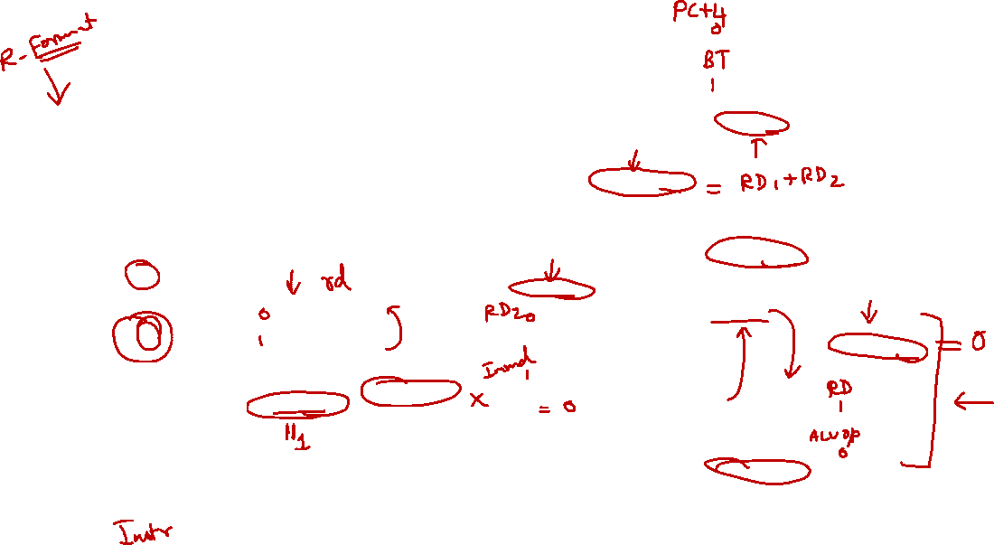
Complete Datapath
Instruction
Memory
PC
Add
MUX
Instruction
4
Left Shift 2-bit
Add
Address
PCSrc
ALUcontrol
Inst [25:21]
5
4
RR1
RD1
Inst [20:16]
5
RR2
is0?
MemWrite
Register
File
ALUSrc
ALU
opcode
31:26
rs
25:21
rt
20:16
rd
15:11
shamt
10:6
5
000000
01001
01010
01000
funct
5:0
WR
ALU
result
00000
MUX
100000
Address
RD2
MUX
WD
Data
Memory
MemToReg
Inst [15:11]
RegWrite
Read
Data
MUX
RegDst
Write
Data
Inst [15:0]
Sign Extend
MemRead

Slide 4

1. Identified Control Signals
Control Signal | Execution Stage | Purpose
RegDst | Decode/Operand Fetch | Select the destination register number
RegWrite | Decode/Operand Fetch RegWrite | Enable writing of register
ALUSrc | ALU | Select the 2nd operand for ALU
ALUcontrol | ALU | Select the operation to be performed
MemRead / MemWrite | Memory | Enable reading/writing of data memory
MemToReg | RegWrite | Select the result to be written back to register file
PCSrc | Memory/RegWrite | Select the next PC value

Slide 5
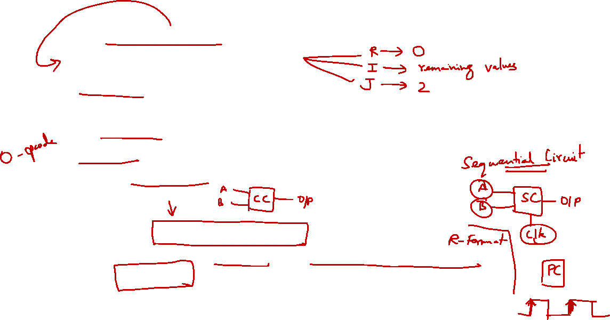
2. Generating Control Signals: Idea
The control signals are generated based on the instruction to be executed:
Opcode ➔ Instruction Format
Example:
R-Format instruction ➔ RegDst = 1 (use Inst[15:11]) )
R-Type instruction has additional information:
The 6-bit "funct" (function code, Inst[5:0]) field
Idea:
Design a combinational circuit to generate these signals based on Opcode and possibly Function code
A control unit is needed (a draft design is shown next)

Slide 6
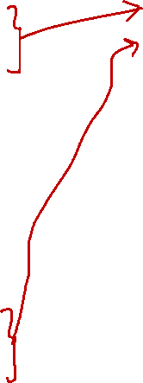
The Control Unit (draft)
Instruction
Memory
PC
Add
MUX
Instruction
4
Left Shift 2-bit
Add
Address
Control
PCSrc
ALUcontrol
Inst [25:21]
5
4
RR1
RD1
Inst [20:16]
5
RR2
is0?
MemWrite
Register
File
ALUSrc
ALU
opcode
31:26
rs
25:21
rt
20:16
rd
15:11
shamt
10:6
5
000000
01001
01010
01000
funct
5:0
WR
ALU
result
00000
MUX
100000
Address
RD2
MUX
WD
Data
Memory
MemToReg
Inst [15:11]
RegWrite
Read
Data
MUX
RegDst
Write
Data
Inst [15:0]
Sign Extend
MemRead

Slide 7
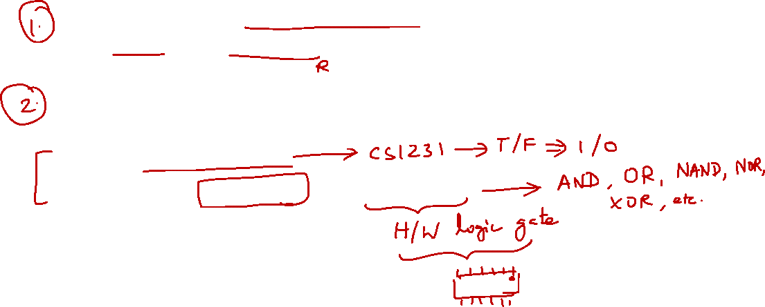
3. Let’s Implement the Control Unit!
Approach:
Take note of the instruction subset to be implemented:
Opcode and Function Code (if applicable)
Go through each signal:
Observe how the signal is generated based on the instruction opcode and/or function code
Construct truth table
Design the control unit using logic gates

Slide 8
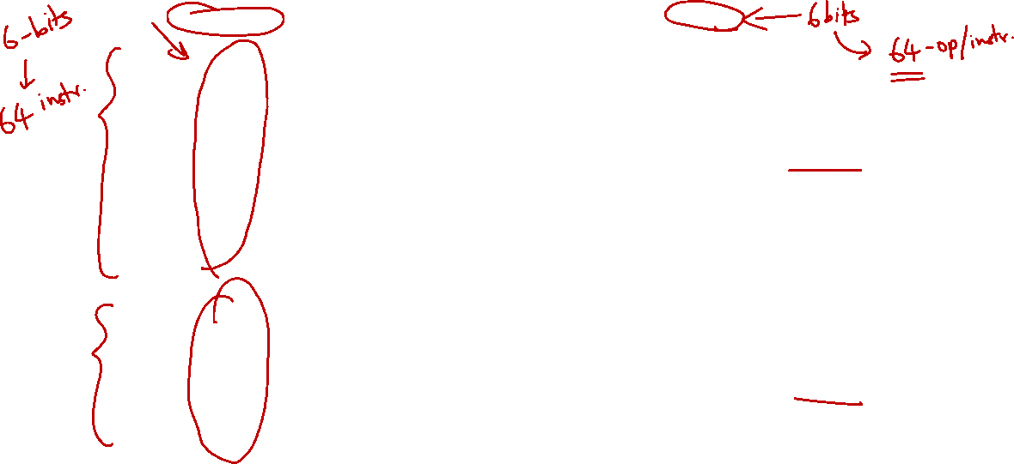
3. MIPS Instruction Subset (Review)
opcode
shamt
funct
31
25
20
15
10
5
add
0₁₆
rs
rt
rd
0
20₁₆
sub
0₁₆
rs
rt
rd
0
22₁₆
and
0₁₆
rs
rt
rd
0
24₁₆
R-type
or
0₁₆
rs
rt
rd
0
25₁₆
slt
0₁₆
rs
rt
rd
0
2A₁₆
31
25
20
15
lw
23₁₆
rs
rd
offset
sw
2B₁₆
rs
rd
offset
I-type
beq
4₁₆
rs
rd
offset

Slide 9
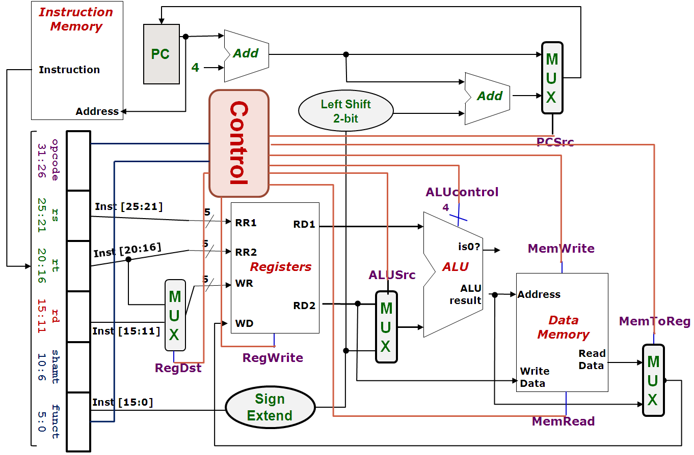
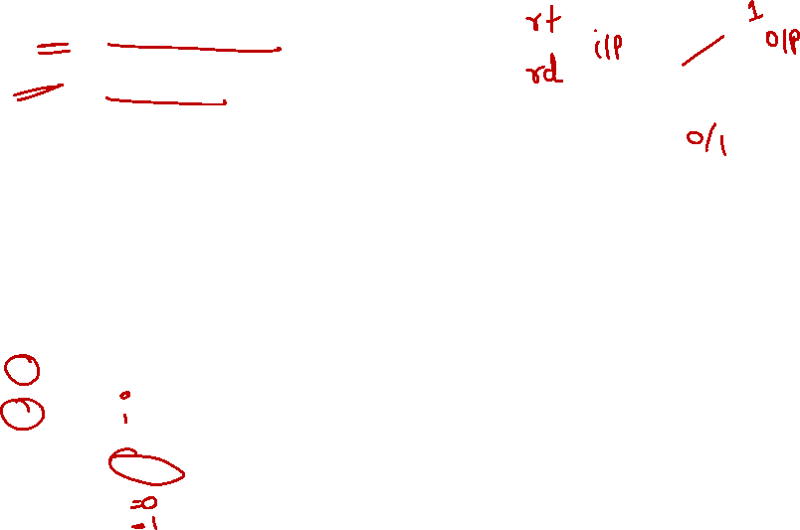
4. Control Signal: RegDst
False (0): Write register = Inst[20:16]
True (1): Write register = Inst[15:11]
0
MUX
1
Signal

Slide 10
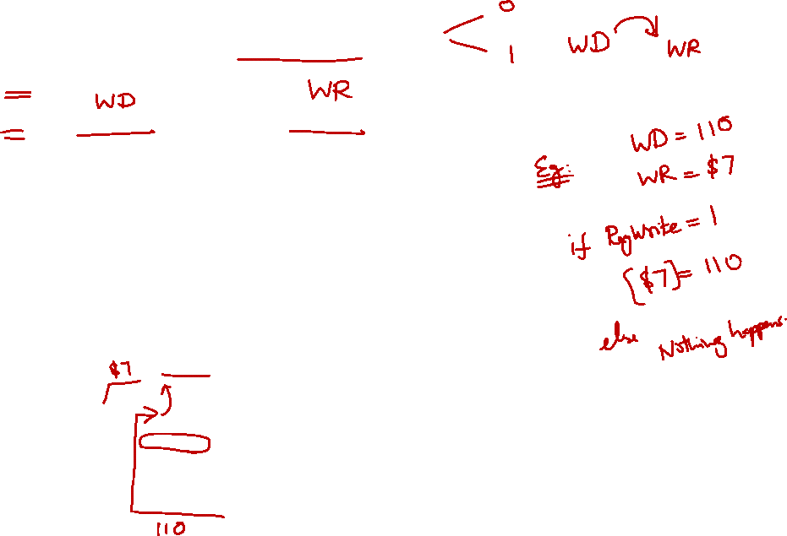
4. Control Signal: RegWrite
False (0): No register write
True (1): New value will be written

Slide 11
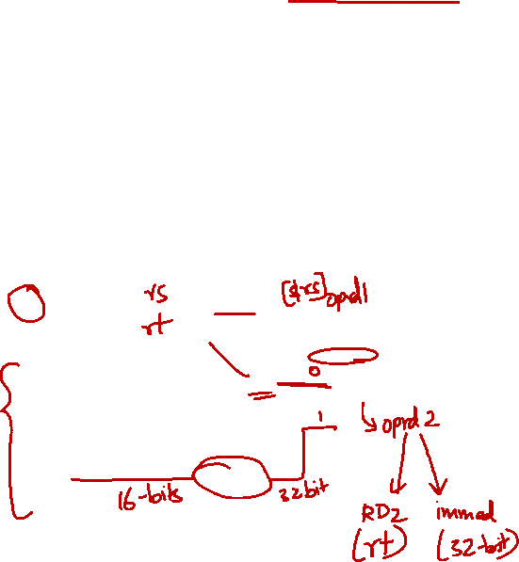
4. Control Signal: ALUSrc
False (0): Operand2 = Register Read Data 2
True (1): Operand2 = SignExt(Inst[15:0])

Slide 12
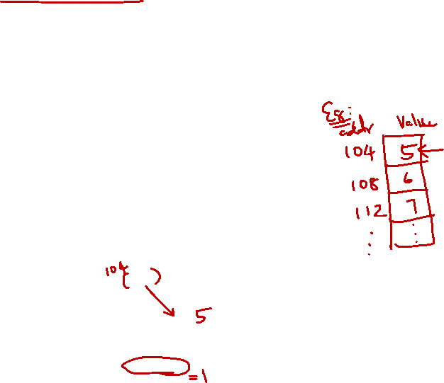
4. Control Signal: MemRead
False (0): Not performing memory read access
True (1): Read memory using Address

Slide 13
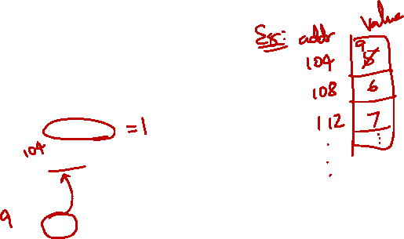
4. Control Signal: MemWrite
False (0): Not performing memory write operation
True (1): memory[Address] ⬅ Register Read Data 2

Slide 14
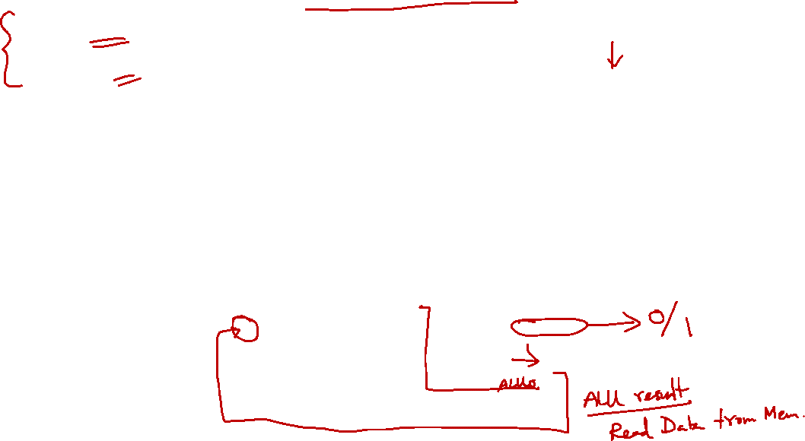
4. Control Signal: MemToReg
True (1): Register write data = Memory read data
False (0): Register write data = ALU result
1
MUX
0
Signal
IMPORTANT:
The input of MUX is swapped in this case

Slide 15
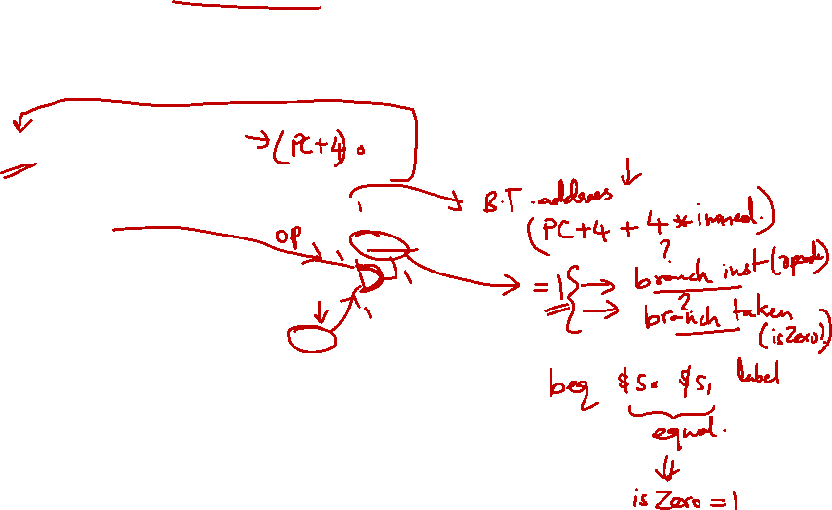
4. Control Signal: PCSrc (1/2)
The "isZero?" signal from the ALU gives us the actual branch outcome (taken/not taken)
Idea: “If instruction is a branch AND taken, then…”

Slide 16
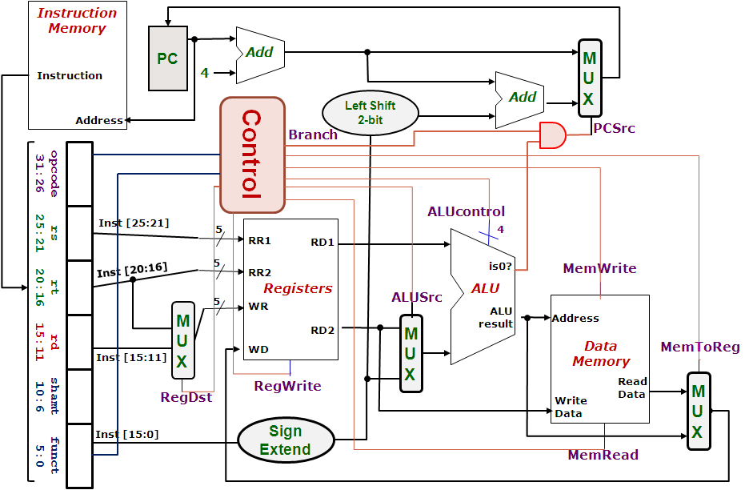
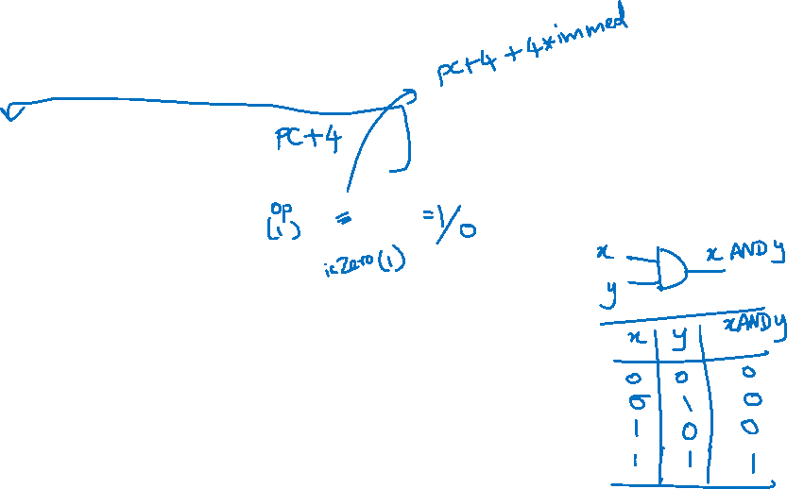
4. Control Signal: PCSrc (2/2)
False (0): Next PC = PC + 4
True (1): Next PC = SignExt(Inst[15:0]) << 2 + (PC + 4)
PCSrc =
( Branch AND isZero)

Slide 17
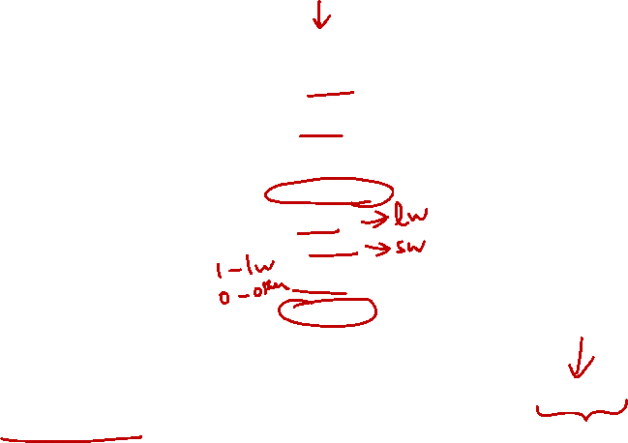
4. Midpoint Check
Control Signal | Execution Stage | Purpose
RegDst | Decode/Operand Fetch | Select the destination register number
RegWrite | Decode/Operand Fetch RegWrite | Enable writing of register
ALUSrc | ALU | Select the 2nd operand for ALU
ALUcontrol | ALU | Select the operation to be performed
MemRead / MemWrite | Memory | Enable reading/writing of data memory
MemToReg | RegWrite | Select the result to be written back to register file
PCSrc | Memory/RegWrite | Select the next PC value
We have gone through almost all of the signals:
Left with the more challenging ALUcontrol signal
Observation so far:
The signals discussed so far can be generated by opcode directly
Function code is not needed up to this point
A major part of the controller can be built based on opcode alone

Slide 18

The Control Unit v0.5
Instruction
Memory
PC
Add
MUX
Instruction
4
Left Shift 2-bit
Add
Address
PCSrc
Control
Branch
Inst [31:26]
Inst [25:21]
5
RR1
RD1
Inst [20:16]
5
RR2
is0?
MemWrite
Registers
ALUSrc
ALU
opcode
31:26
rs
25:21
rt
20:16
rd
15:11
shamt
10:6
5
funct
5:0
WR
ALU
result
MUX
Address
RD2
MUX
WD
Data
Memory
MemToReg
Inst [15:11]
4
RegWrite
ALUcontrol
Read
Data
MUX
RegDst
Write
Data
Inst [15:0]
Sign Extend
MemRead

Slide 19
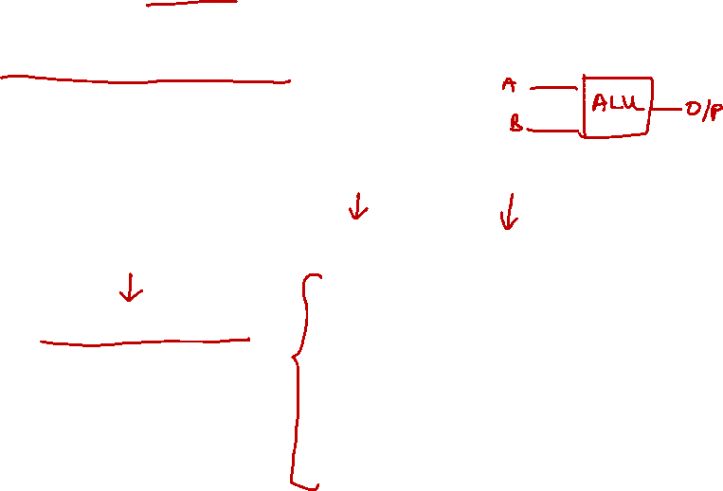
5. Closer Look at ALU
Note: We will cover combinational circuits after the recess.
The ALU is a combinational circuit:
Capable of performing several arithmetic operations
In Lecture #11:
We noted the required operations for the MIPS subset
ALUcontrol | Function
0000 | AND
0001 | OR
0010 | add
0110 | subtract
0111 | slt
1100 | NOR
Question:
How is the ALUcontrol signal designed?

Slide 20
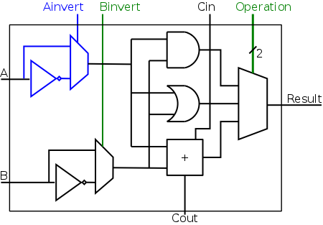
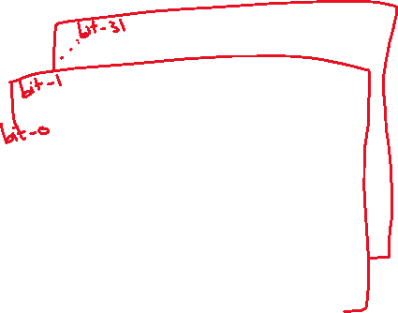
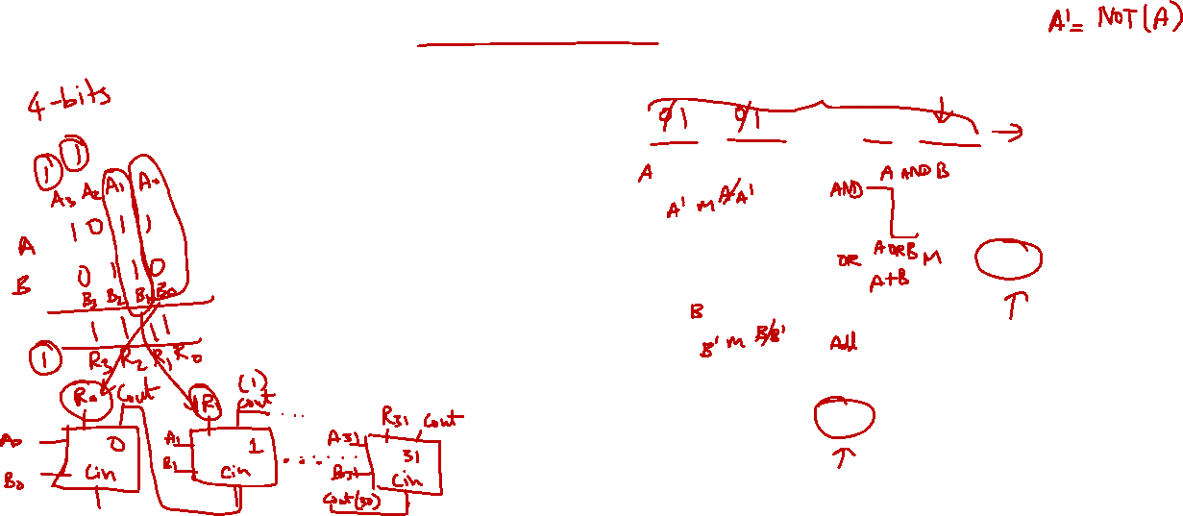
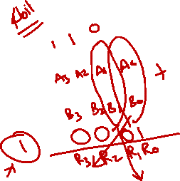
Note: We will revisit this when we cover combinational circuits later.
5. One Bit At A Time
A simplified 1-bit MIPS ALU can be implemented as follows:
4 control bits are needed:
Ainvert:
1 to invert input A
Binvert:
1 to invert input B
Operation (2-bit)
To select one of the 3 results
Acknowledgement: Image taken from NYU Course CSCI-UA.0436

Slide 21
Note: We will revisit this when we cover combinational circuits later.
5. One Bit At A Time
A simplified 1-bit MIPS ALU can be implemented as follows:
4 control bits are needed:
Ainvert:
1 to invert input A
Binvert:
1 to invert input B
Operation (2-bit)
To select one of the 3 results
Acknowledgement: Image taken from NYU Course CSCI-UA.0436

Slide 22
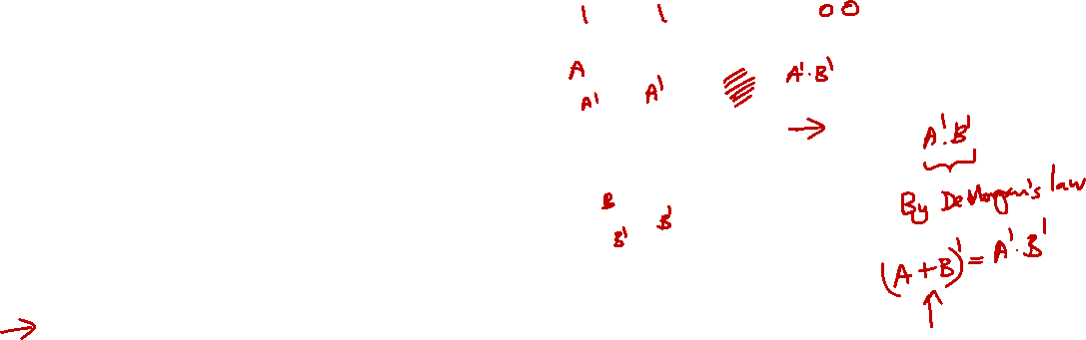
5. One Bit At A Time (Aha!)
Can you see how the ALUcontrol (4-bit) signal controls the ALU?
Note: implementation for slt not shown
ALUcontrol |  |  | Function
Ainvert | Binvert | Operation
0 | 0 | 00 | AND
0 | 0 | 01 | OR
0 | 0 | 10 | add
0 | 1 | 10 | subtract
0 | 1 | 11 | slt
1 | 1 | 00 | NOR
Acknowledgement: Image taken from NYU Course CSCI-UA.0436

Slide 23
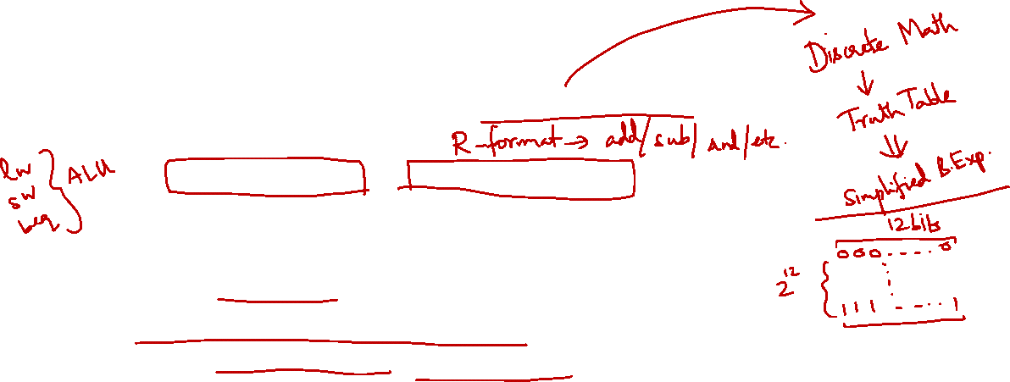
5. Multilevel Decoding
Now we can start to design for ALUcontrol signal, which depends on:
Opcode (6-bit) field and Function Code (6-bit) field
Brute Force approach:
Use Opcode and Function Code directly, i.e. finding expressions with 12 variables
Multilevel Decoding approach:
Use some of the input to reduce the cases, then generate the full output
Simplify the design process, reduce the size of the main controller, potentially speedup the circuit

Slide 24
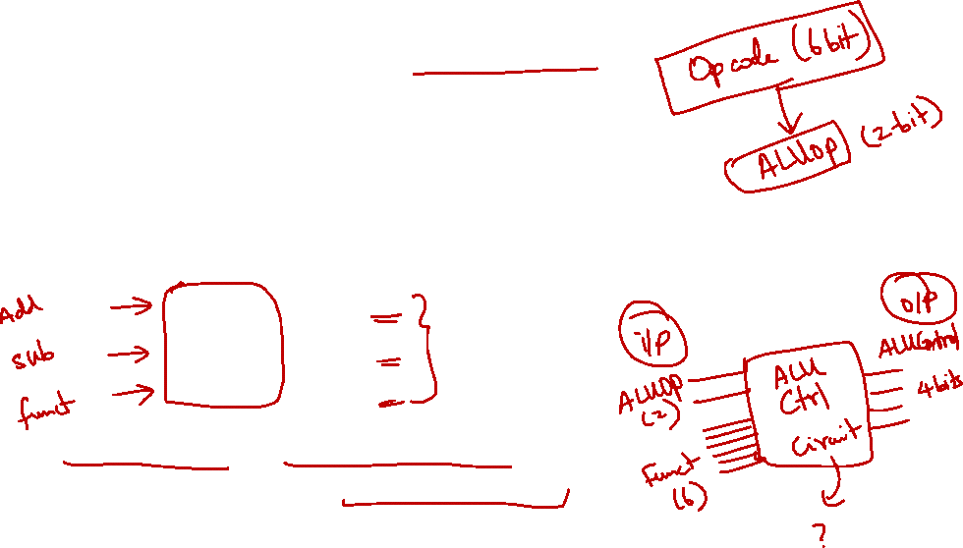
5. Intermediate Signal: ALUop
Basic Idea:
Use Opcode to generate a 2-bit ALUop signal
Represents classification of the instructions:
Use ALUop signal and Function Code field (for R-type instructions) to generate the 4-bit ALUcontrol signal
Instruction type | ALUop
lw / sw | 00
beq | 01
R-type | 10

Slide 25
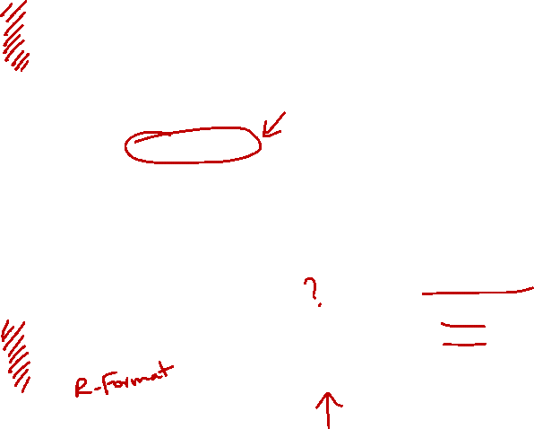
5. Two-level Implementation
Step 1.
Generate 2-bit ALUop signal from 6-bit opcode.
6
Control
Step 2.
Generate ALUcontrol signal from ALUop and optionally 6-bit Funct field.
ALUop
2
00: lw, sw
01: beq
10: add, sub, and, or, slt
opcode
31:26
rs
25:21
rt
20:16
rd
15:11
shamt
10:6
funct
5:0
ALU
4
ALUcontrol
0000: and
0001: or
0010: add
0110: sub
0111: set on less than
ALU Control
6

Slide 26
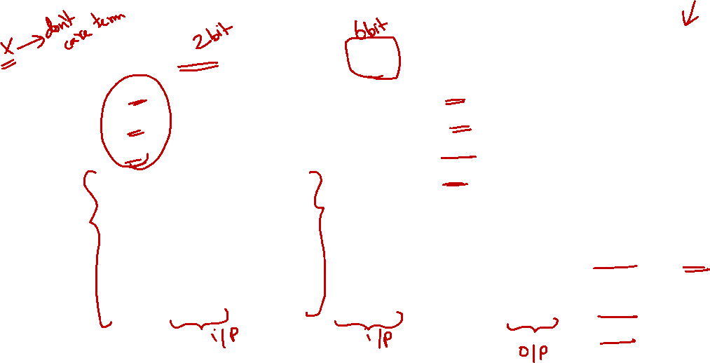
5. Generating ALUcontrol Signal
Opcode | ALUop | Instruction Operation | Funct field | ALU action | ALU control
lw |  | load word |  | add
sw |  | store word |  | add
beq |  | branch equal |  | subtract
R-type |  | add |  | add
R-type |  | subtract |  | subtract
R-type |  | AND |  | AND
R-type |  | OR |  | OR
R-type |  | set on less than |  | set on less than
Instruction Type | ALUop
lw / sw | 00
beq | 01
R-type | 10
00
xxxxxx
0010
00
xxxxxx
0010
01
xxxxxx
0110
10
10 0000
0010
10
10 0010
0110
10
10 0100
0000
ALUcontrol | Function
0000 | AND
0001 | OR
0010 | add
0110 | subtract
0111 | slt
1100 | NOR
10
10 0101
0001
10
10 1010
0111
Generation of 2-bit ALUop signal will be discussed later


Slide 27
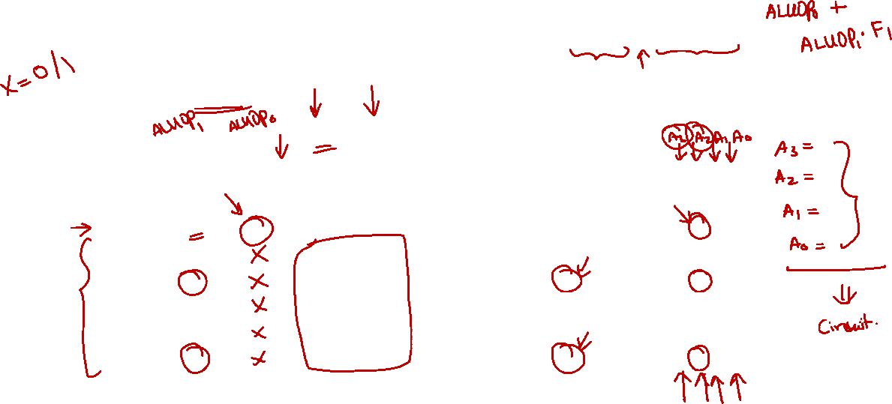
5. Design of ALU Control Unit (1/2)
Input: 6-bit Funct field and 2-bit ALUop
Output: 4-bit ALUcontrol
Find the simplified expressions
ALUcontrol3 = 0
ALUcontrol2 = ?
ALUop0 + ALUop1⋅ F1
 | ALUop |  | Funct Field ( F[5:0] == Inst[5:0] ) |  |  |  |  |  | ALU control
 | MSB | LSB | F5 | F4 | F3 | F2 | F1 | F0
lw
sw
beq
add
sub
and
or
slt
0
0
X
X
X
X
X
X
0 0 1 0
0
0
X
X
X
X
X
X
0 0 1 0
X
0
1
X
X
X
X
X
X
0 1 1 0
1
0
X
1
X
0
X
0
0
0
0
0 0 1 0
1
0
1
0
0
0
1
0
0 1 1 0
X
X
X
1
0
X
1
X
0
X
0
1
0
0
0 0 0 0
1
0
1
0
0
1
0
1
0 0 0 1
X
X
X
1
X
X
X
0
1
0
1
0
1
0
0 1 1 1


Slide 28
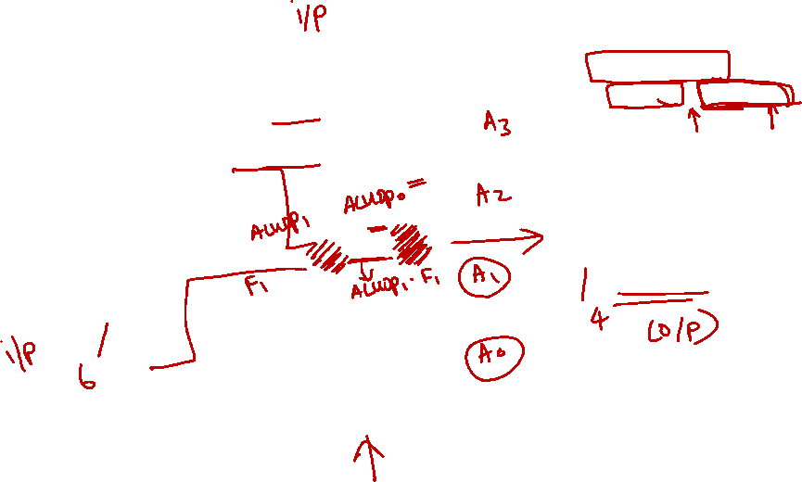
5. Design of ALU Control Unit (2/2)
Simple combinational logic
Note: We will revisit this when we cover combinational circuits later.
ALUop
2
ALU Control block
ALUcontrol2
= ALUOp0 + ALUOp1∙F1
ALUOp0 (LSB)
ALUOp1 (MSB)
ALUcontrol3
0
ALUcontrol2
F3
ALUcontrol1
ALUcontrol
F2
F(5-0)
F1
ALUcontrol0
F0

Slide 29
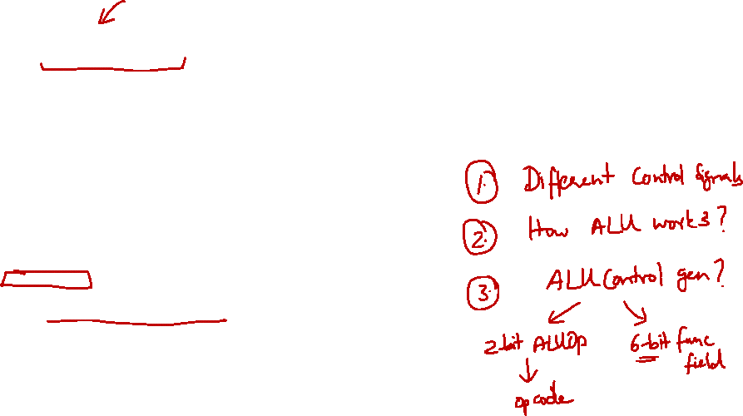
5. Finale: Control Design
We have now considered all individual signals and their expected values
Ready to design the controller itself
Typical digital design steps:
Fill in truth table
Input: Opcode
Output: Various control signals as discussed
Derive simplified expression for each signal

Slide 30
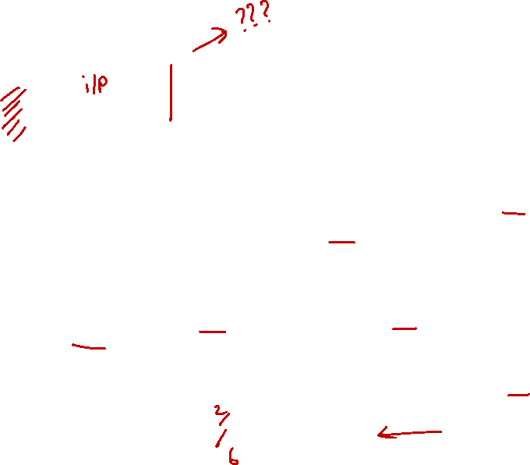
Datapath & Control
Instruction
Memory
PC
Add
MUX
Instruction
4
Left Shift 2-bit
Add
Address
PCSrc
Control
Branch
Inst [31:26]
Inst [25:21]
5
RR1
RD1
Inst [20:16]
5
RR2
is0?
MemWrite
Registers
ALUSrc
ALU
opcode
31:26
rs
25:21
rt
20:16
rd
15:11
shamt
10:6
5
funct
5:0
WR
ALU
result
MUX
Address
RD2
MUX
WD
Data
Memory
MemToReg
Inst [15:11]
4
RegWrite
ALUcontrol
Read
Data
MUX
RegDst
Write
Data
Inst [15:0]
Sign Extend
Inst [5:0]
MemRead
ALUop
ALU Control

Slide 31
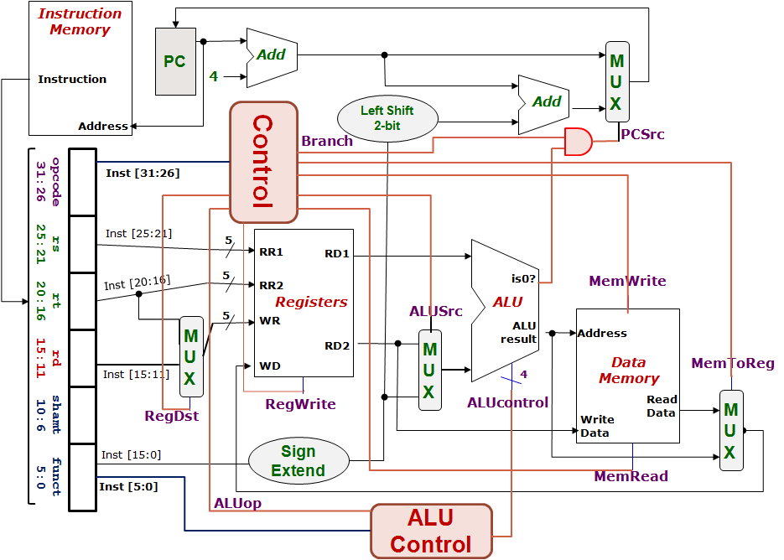
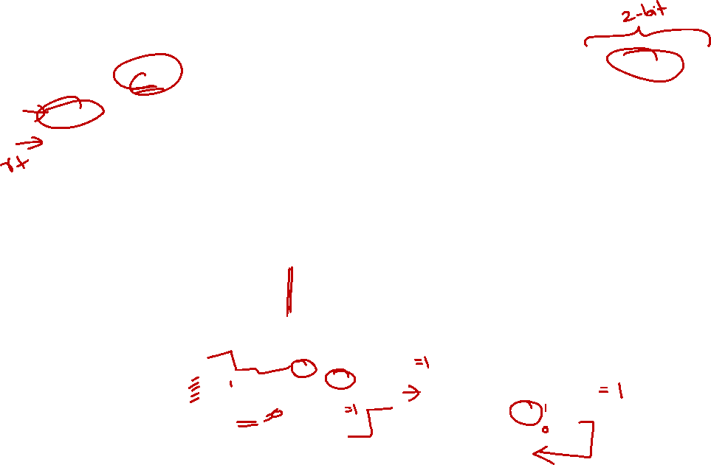
5. Control Design: Outputs
 | RegDst | ALUSrc | MemToReg | Reg Write | Mem Read | Mem Write | Branch | ALUop
 |  |  |  |  |  |  |  | op1 | op0
R-type
lw
sw
beq
1
0
0
1
0
0
0
1
0
0
1
1
1
1
0
0
0
0
X
1
X
0
0
1
0
0
0
X
0
X
0
0
0
1
0
1


Slide 32
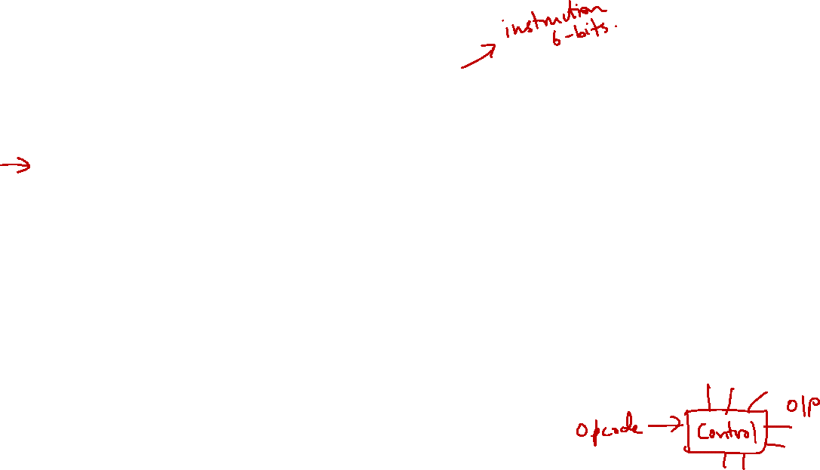
5. Control Design: Inputs
 | Opcode ( Op[5:0] == Inst[31:26] )
 | Op5 | Op4 | Op3 | Op2 | Op1 | Op0 | Value in Hexadecimal
R-type
lw
sw
beq
0
0
0
0
0
0
0
1
0
0
0
1
1
23
1
0
1
0
1
1
2B
0
0
0
1
0
0
4
With the input (opcode) and output (control signals), let’s design the circuit

Slide 33

5. Combinational Circuit Implementation
 | Opcode
 | Op5 | Op4 | Op3 | Op2 | Op1 | Op0
R-type | 0 | 0 | 0 | 0 | 0 | 0
lw | 1 | 0 | 0 | 0 | 1 | 1
sw | 1 | 0 | 1 | 0 | 1 | 1
beq | 0 | 0 | 0 | 1 | 0 | 0
Opcode
Control Signals

Slide 34
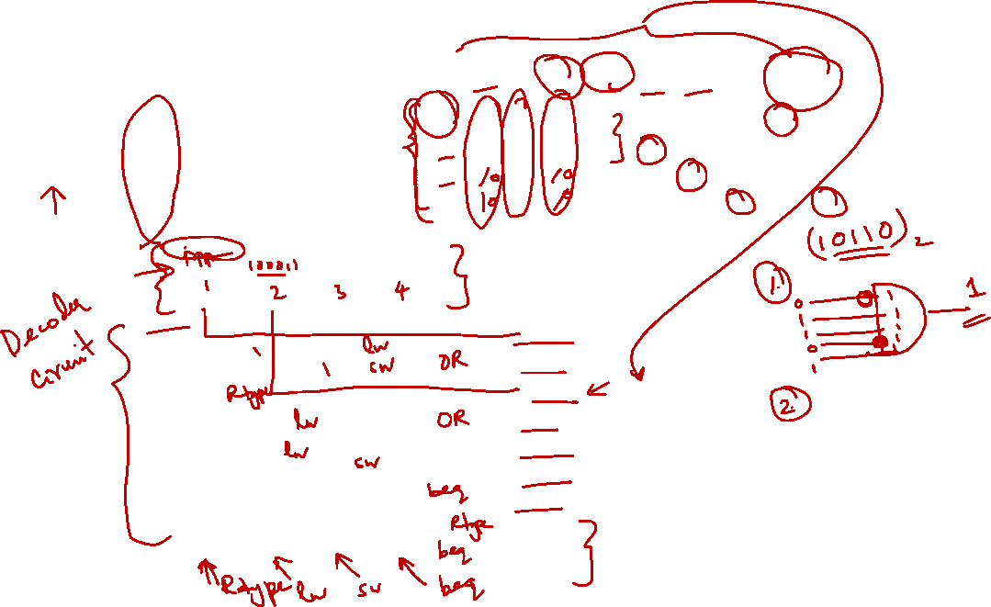
5. Combinational Circuit Implementation
 | RegDst | ALUSrc | MemToReg | Reg Write | Mem Read | Mem Write | Branch | ALUop
 |  |  |  |  |  |  |  | op1 | op0
R-type | 1 | 0 | 0 | 1 | 0 | 0 | 0 | 1 | 0
lw | 0 | 1 | 1 | 1 | 1 | 0 | 0 | 0 | 0
sw | X | 1 | X | 0 | 0 | 1 | 0 | 0 | 0
beq | X | 0 | X | 0 | 0 | 0 | 1 | 0 | 1
Opcode
Control Signals

Slide 35
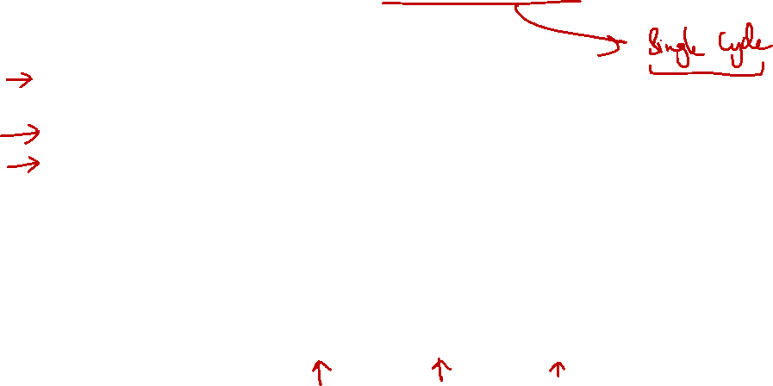
6. Big Picture: Instruction Execution
Instruction Execution =
Read contents of one or more storage elements (register/memory)
Perform computation through some combinational logic
Write results to one or more storage elements (register/memory)
All these performed within a clock period
Clock Period
Clock
Read
Compute
Write
Don’t want to read a storage element when it is being written.

Slide 36
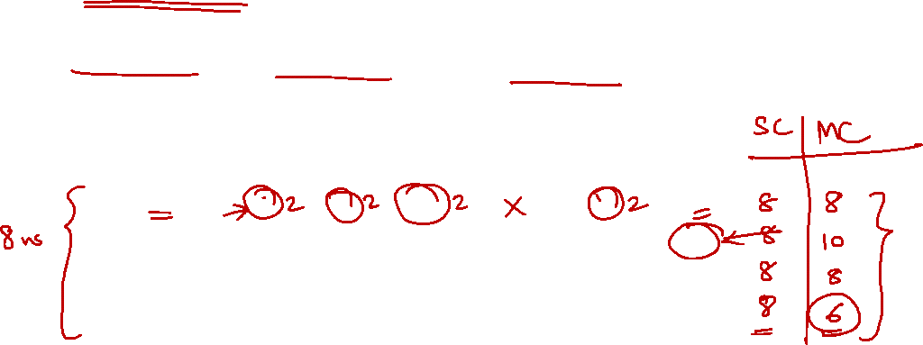
6. Single Cycle Implementation: Shortcoming
Calculate cycle time assuming negligible delays: memory (2ns), ALU/adders (2ns), register file access (1ns)
Instruction | Inst Mem | Reg read | ALU | Data Mem | Reg write | Total
ALU | 2 | 1 | 2 |  | 1 | 6
lw | 2 | 1 | 2 | 2 | 1 | 8
sw | 2 | 1 | 2 | 2 |  | 7
beq | 2 | 1 | 2 |  |  | 5
All instructions take as much time as the slowest one (i.e., load)
➔ Long cycle time for each instruction

Slide 37
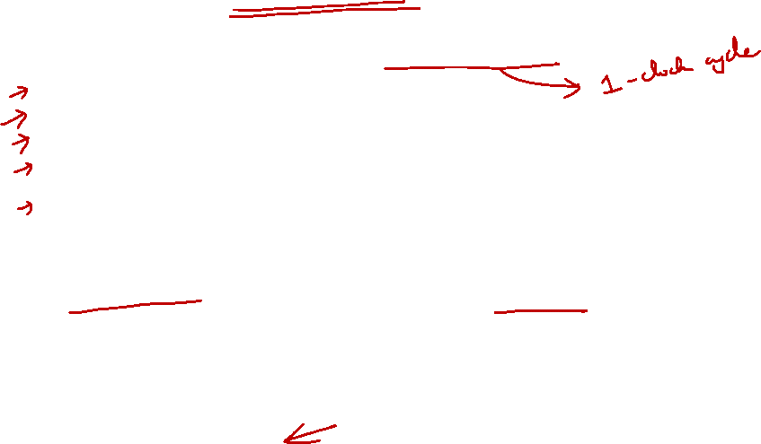
6. Solution #1: Multicycle Implementation
Break up the instructions into execution steps:
Instruction fetch
Instruction decode and register read
ALU operation
Memory read/write
Register write
Each execution step takes one clock cycle
➔ Cycle time is much shorter, i.e., clock frequency is much higher
Instructions take variable number of clock cycles to complete execution
Not covered in class:
See Section 5.5 of COD if interested

Slide 38

6. Solution #2: Pipelining
Break up the instructions into execution steps one per clock cycle
Allow different instructions to be in different execution steps simultaneously
Covered in a later lecture

Slide 39
Summary
A very simple implementation of MIPS datapath and control for a subset of its instructions
Concepts:
An instruction executes in a single clock cycle
Read storage elements, compute, write to storage elements
Datapath is shared among different instructions types using MUXs and control signals
Control signals are generated from the machine language encoding of instructions

Slide 40
Reading
The Processor: Datapath and Control
COD Chapter 5 Sections 5.4 (3rd edition)
COD Chapter 4 Sections 4.4 (4th edition)
Exploration:
ALU design and implementation:
4th edition (MIPS): Appendix C
http://cs.nyu.edu/courses/fall11/CSCI-UA.0436-001/class-notes.html

Slide 41
End of File

